Slide 1

Social Development: A Situational Analysis of Aruba Case

Slide 2
Departure point
We posit that while economic growth is deemed a condition for economic development and social development, it could go hand in hand with increased unemployment rate, diminishing educational attainment level, worsening working conditions, expanding inequality in income distribution, reduced social participation and worsened perception of well-being and general satisfaction under the population.

Slide 3
Departure point
In the effort to assess the state of and the advancement in economic condition and social development in Aruba, we adhered to the multidimensional concept of quality of life.
This concept includes besides material aspects such as income and properties, also access to:
healthcare, education, (decent) work, availability and access to social services, social relations and natural environment. It also encompasses the subjective perception of living conditions and people’s subjective well-being in terms of personal satisfaction and happiness.
Hence, the goal is to combine economic growth and reduction in inequality.

Slide 4
In 2010, 43 percent of the economic active population was foreign-born.
 | Both partners Aruba-born | Both partner foreign-born | Female partner born in Aruba | Male partner born in Aruba
2000 Census | 46% | 29% | 8% | 17%
2010 Census | 43% | 28% | 10% | 19%
In 2010 one in ten Aruban females and circa one out of every five males had a foreign-born spouse. For the local males their spouses were mainly from the Latin American region (71%), with over half (55.4%) being born in Colombia, followed by the (former) Netherlands Antilles (9%) and Holland (8%). CBS Aruba.

Slide 5
Migration

Slide 6
15,660 Total 60-plussers in 2010 that is projected to grow to 36,077 by the year 2030. By early 2020’s there will be more people age 60 and over than below age 15. One in five (20.3%) of the total population would be 60-plussers. Population proportional change (1960-100%) by age-group and census year

Slide 7
Marriages and divorce
Percentage of population (all age-groups) married and divorced by census year
Married Divorced | 1972 | 1981 | 1991 | 2000 | 2010
 | 31.9 | 36.1 | 37.7 | 37.2 | 34.7
 | 1.6 | 3.3 | 6.2 | 7.3 | 9.6

Slide 8
Marriages and divorces
1.6% - 9.6%
Ascertained divorcees (of all ages) under total population in 1972 and 2010.
Top Five
Aruba’s global ranking with 4.5 divorces per thousand people in 2013.

Slide 9
Family structure
71% and 45%
Proportions of nuclear households in 1981 and 2010. Composite households grew from 2.5% to 17%, and one-person households increased from 11.8% to 21% .
Four in ten
38.6% of Aruba-born and 26.5% foreign-born mothers was single parent in 2010.

Slide 10
ECONOMIC AND SOCIAL DEVELOPMENT
Economic growth is judged a necessary but not sufficient condition for economic development.
Social development is directly or indirectly related to economic development and pertains to improvements in living condition (improved health, better education, affordable housing, employment and better wages and working conditions, improved wellbeing) and the standard of living in general. Working definitions of economic development often encompass social development. For the purposes of this work, social development refers to the social structures of the society, availability of and access to social services, social justice, the social status and quality of life in general.
It is argued that unwarranted social disparities adversely impact balanced socioeconomic development and concomitantly the quality of life.

Slide 11
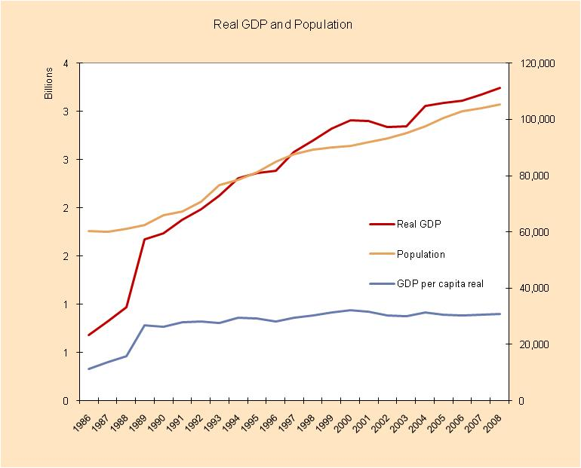
Economic growth and development (Source: CBS Aruba)

Slide 12
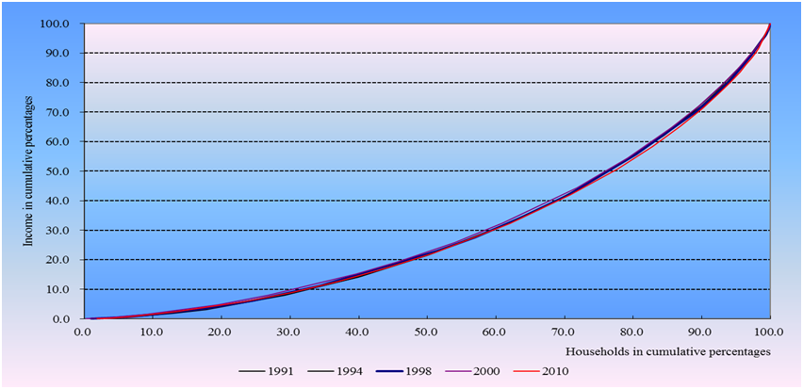
Economic growth and development
Lorenz curve for the 1991 – 2010 period

Slide 13
Economic growth and development (Chart below not included in the discussion paper)
“Real wages have been stagnant across the entire income distribution since 2006. This is consistent with the weak macroeconomic performance.
On the other hand, stagnant real wages also imply that income inequality has not materially changed over the past decade.” Source: 2017 IMF Country Report Aruba. Page 6. Available at: https://www.imf.org/en/Publications/CR/Issues/2017/06/15/Kingdom-of-the-Netherlands-Aruba-2017-Article-IV-Consultation-Press-Release-and-Staff-Report-44988

Slide 14
Economic growth and development
Table 18 (Projected) youth unemployment rate by region by 2010 (ILO)
REGION | YOUTH UNEMPLOYMENT RATE (%)
WORLD | 13.1
Developed Economies & European Union | 19.1
Central & South –Eastern Europe (non-EU & CIS) | 20.2
East Asia | 8.4
South East Asia & the Pacific | 14.8
South Asia | 10.3
Latin America & The Caribbean | 15.8
Middle East | 23.7
North Africa | 23.8
Sub-Saharan Africa | 12.3
ARUBA | 28.9
Based on recent Labor surveys the youth unemployment rate dropped to 23.5% in 2011, 22.8% in 2014 and 18.2% in 2015. On the other hand, the economic inactive youths increased with estimated 525 cases in 2015 compared to 2014, which represents about 7 percent of the concerned population in 2015.

Slide 15
Table 19 Unemployment of population younger than 25 years old
by highest level diploma, sex and total (Population and Housing Census 2010)
Level of Diploma | Unemployed |  | Unemployment rate |  | Unemployment rate Total
 | Male | Female | Male | Female
Less than primary education | 32 | 14 | 39.0% | 34.1% | 66.5%
Primary (special) education | 409 | 273 | 34.7% | 33.3% | 34.2%
Lower vocational education (EPB) | 214 | 121 | 24.9% | 26.1% | 26.1%
Mavo | 110 | 132 | 22.3% | 23.2% | 22.8%
Havo/High school Bachillerato | 41 | 55 | 21.7% | 22.1% | 21.9%
VWO | 0 | 6 | 0% | 20.0% | 14.6%
Vocational associate (MBO) | 15 | 30 | 7.9% | 11.1% | 9.7%
Higher education (WO, Master) | 2 | 4 | 20.0% | 28.6% | 25.0%

Slide 16
Economic growth and development
Table 5 Linear relationship between real GDP and unemployment rate by period.
PERIOD | 1991-2000 | 2001-2014 | 1991-2014
Pearson r | .787 | -.64 | -.270
Notwithstanding the relatively high unemployment rates throughout this century, just one year of negative net migration was registered since the year 1990.

Slide 17
Economic growth and development
… one in five households (20.7%) in Aruba was deemed poor....the number of households with an income below 60% of the median threshold in 2010 totalled 7,202 households ...
Relative Poverty Line | Relative | Total households* below poverty line | Minimum wage (Afl.)
Afl. 1,380 (60% of median income) | 20.7% | 7,202 | 1,543
Afl. 1,610 (70% of median income) | 27.1% | 9,460 | 1,543
Afl. 1,150 (50% of median income) | 15.7% | 5,486 | 1,543

Slide 18
Subjective well-being
According to AWS-09* data:
One in six Aruba-born adults and 21% of foreign-born reported being treated unfairly or unequally.
One in ten Aruba-born and one in five foreign-born adults claimed to have been discriminated against.
Merely Five % stated that one can trust most people.
A majority (54%) disagreed with the statement that social differences in Aruba are just and fair.
44.6% felt that life has become so complicated that they cannot find their way.
About every third (32.3%) adult male and one in two (50.6%) adult female reported to completely agree with the statement that they often feel lonely.
On the other hand, we are rather happy -77% - (and 78% in 2016 according to Aruba 360 Degree project) and satisfied people (life-satisfaction mean rate of 7.9 on a 0-10 Likert scale in the year 2009 ranked it amongst the top in the world comparable to that of The Netherlands in 2006.

Slide 19
Feeling safe and protected
LIKELIHOOD TO: | Very likely/Rather likely (%)
Become a victim of burglary or break in at home (n=749) | 44.6
Get things stolen from you (n=753) | 39.0
Be attacked and robbed (n=753) | 31.6
Be harassed or threatened (n=753) | 17.5
Be beaten and hurt (n=753) | 14.5
Be sexually molested (n=755) | 6.5
Table 11 Recorded police crimes per 100.000 people by type, selected OECD countries
the year 2010 and Aruba in the year 2013
Country | Assault | Burglary | Auto thefts
Scotland | 1,449.7 | 479.1 | 166.9
Sweden | 936.6 | 988.5 | 373.2
England and Wales | 664.4 | 946.1 | 192.3
Belgium | 719.8 | 879.9 | 184.6
Netherlands | 353.0 | 960.7 | 129.2
United States | 250.9 | 695.9 | 237.5
Mexico | 203.4 | 168.9 | 202.7
Japan | 44.4 | 107.9 | 76.9
Poland | 1.4 | 366.0 | 43.2
Aruba | - | 837.5 | 1,220.7

Slide 20
Access to and output of education
We’ve practically full school participation at the primary and secondary levels and just 3% illiteracy rate.
Nonetheless, four in ten (42%) of the youths (ages 15-24) not attending school did not graduate from a secondary school in 2010, which represents an increase of 5% over 2000 Census.
Thirty 30 percent is the target of the population with a higher education neces- sary for functional basis for a knowledge economy. Aruba is far below this norm.
We have yet to meet the UNESCO’s target of (at least) 6% of GDP and 20% of total public spending in education - 2002-11: high of 4.8% in ’03 and 12.4% in ’10 –.
From 2006 until 2013 just between 1/5th and 1/3rd of the graduates in Holland returned and between +10% and +26% or 1,878 students cut their studies.
Twelve percent of the population in 2010 had completed an education equivalent to a bachelor degree or higher of which just 36% was born in Aruba.
The repetition rate at primary level and failure rate for the final exam at secondary level is notably high/

Slide 21
Access to and output of education
SCHOOLS | 2006/2007 | 2007/2008 | 2008/2009 | 2009/2010 | 2010/2011 | 2011/2012 | 2012/2013 | 2007-2013 AVERAGE*
MAVO | 78 | 72 | 69 | 73 | 78 | 82 | 75 | 75%
HAVO | 56 | 73 | 51 | 58 | 67 | 74 | 67 | 65%
VWO | 63 | 65 | 83 | 75 | 66 | 79 | 82 | 73%
EPB | 70 | 78 | 69 | 81 | 83 | 88 | 84 | 79%
EPI | 60 | 61 | 67 | 60 | 67 | 63 | 65 | 63%

Slide 22
Access to and output of education

Slide 23
The face of the needy: (female) single parent household
1/6 (15.4%) nuclear households and circa 7 percent of all non-collective households was one-parent households with dependent children under age 18 (N=2,420) at the time the 2010 Census was administered. In The Netherlands 16% of all families was comprised of a single parent household (with one of more dependent children). Aruba-born male single-parents comprised circa 5% of all fathers born in Aruba.
Circa four in ten (38%) of all the mothers born in Aruba, and around one-fourth foreign-born mothers (25.5%) was single-parent. An important minority (46%) of the single mothers was never married and 40 percent was divorced.
Forty-two percent of the single mothers and 25 percent of the single fathers reported a monthly income of less than Afl. 2,000. We refer to an earlier presented data that the median household monthly income was estimated at Afl. 3.300.
About ten percent of all non-collective households (10.2%) was female headed (mother alone with children of all ages) and the male headed households accounted for a bit more than one percent (1.2%) in 2010. In the year 1991 the percentages were 8.2 percent and 1.0 percent, respectively.
50 percent of the population receiving the “gezinsuitkering” was comprised of one-parent (mostly female) households with children; about half (45%) consisted of one-person households; the group of couples with children accounted for four percent;
one percent was childless couples.
4/10 registered cases of Guia Social was single-parent households, of which the vast majority are female-headed. The majority (67%) of the registered clients of the section “Seccion di Bida y Famia” was comprised of females.
One-third (35%) of the in 2016 recorded heads of households receiving family transfers (“gezinsuitkering”) never held a job.

Slide 24
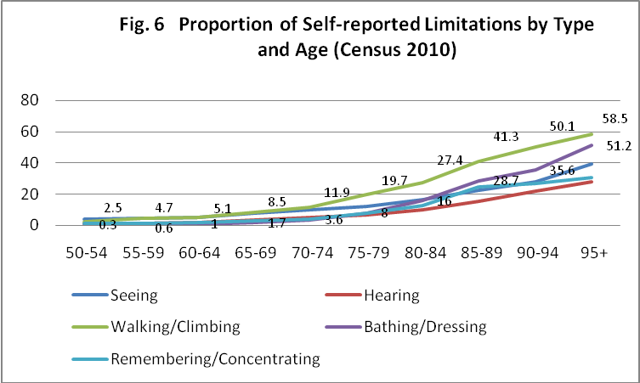
People with special needs

Slide 25
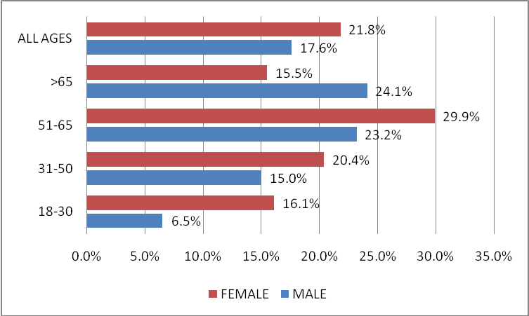
People with special needs
Chart 38 Percentage of respondents reporting being a caregiver for an elderly or disabled
family member by age and sex.

Slide 26
Final remarks
High unemployment rate
Low educational output
A notable and apparent growing number of economic-inactive youth
YOUTH IN CRISIS
Growing number of youth involved in violent crimes
Relatively high teen fertility rate*

Slide 27
Final remarks
Concentrated in the lower income categories.
< Afl. 2000 p.m. Women: 42%
Men: 25% High
Four in ten of the Guia Social’s clientle are single parents
About half of the recipients of ‘gezinsuitkering’ are single-parent (mostly females)
(Female) single parent households are vulnerable
One-third (34%) of female welfare recipients never held a job.
38% of local- born and 25.5% of foreign-born mothers were single-parents in 2010

Slide 28
MANEHO SOCIAL 2017-2020 Directie Sociale Zaken
‘E ser humano central!’

Slide 29
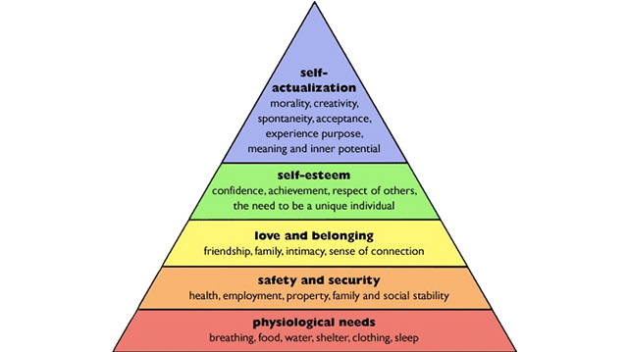
Necesidat di tur ser humano social.

Slide 30
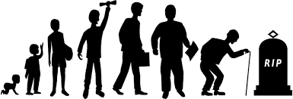
Ciclo di bida di ser humano. - Un ser humano ta un ser social cu ta biba den famia i den un ambiente/bario. - Cada etapa di bida tin su propio retonan i riesgonan!

Slide 31
Tarea di Sociale Zaken i 26 organisashon social
Yuda famia/persona vulnerabel den crisis social /personal/famia.
- a perde of no tin trabou
- mester ayudo legal
- mester di guia social pa famia
- mester di guia psychologico leve
Prevencion pa no cai den crisis social /personal /
famia.
- preveni /interveni foi trempan
- informa pa drecha posicion di mucha, hoben,
famia, seniors i hende special

Slide 32
METANAN PRINCIPAL SOCIAL A LARGO PLAZO PA HENDE VULNERABEL NA ARUBA
Stabilidat i seguridat personal, social, den famia i den bario.
Yuda necesidat basico i boga pa un nivel di pobresa aceptabel!
Motiva mucha/hoben /adulto caba scol, ofishi, formacion i yuda hanja/mantene trabou.
Manera di traha:
Propio desarollo, forza, conocimiento, habilidat i duna herment pa deal mihor cu bida .
Interveni trempan paso esey ta mas efectivo.
Traha huntu cu otro departamento i organisashon.
LEMA: NOS TA YUDA BO YUDA BO MES PA ASINA BO DESAROYA I SIGUI CRECE!

Slide 33
Traha den cadena gobierno/instancianan social.
A.
Rol gobierno/ instantias.
B.
Rol DSZ i 26 orga social
C.
Efecto social

Slide 34
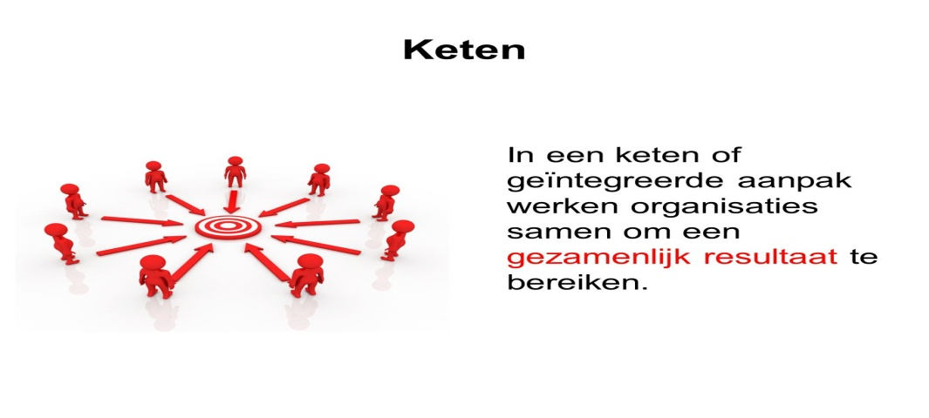
Mester traha conhuntu, interveni trempan i integral pa logra metanan social!

Slide 35
E famia vulnerabel
Otro instancia i gobierno mester na:
Yuda famia hanja i mantene trabou
Traha pa mehora condicion di trabou
Mehora entrada minimo i amplia canasta basico
Suficiente casnan pagabel!
Rol di DSZ:
Detecta tempran riesgo den famia i interveni
Mehora parenting & relationship skills

Slide 36
Hoben i mucha
Rol di Ensenanza, DPL, DAO I Reclassering.
Introduci scol multi lengual cu papiamento
Hisa output den ensenanza
Sinja hoben ofishi i motive pa busca trabou
Duna hoben first offenders guia den bida i trabou
Duna second chance den ensenanza, trabou i bida!
Rol DSZ pa cu ensenanza
Boga/traha na derecho di mucha
Motiva, stimula i guia hoben den trabou
Boga pa output i second chance
Stimula discusion i crea oportunidat pa hoben

Slide 37
Nos hende special i seniors
Hende special
Boga, crea facilidat i guia pa hende special hiba un bida normal.
Crea facildatnan cu falta ainda.
Boga pa ‘ traha segun por’ !
Seniors
Yuda seniors biba un bida activo i saludabel
Evita biba den isolacion
Evita abuso di seniors!

Slide 38
Concept Meerjaren Beleidsplan DSZ 2017-2020 DSZ
Inhoudsopgave
Inleiding
Hoofdstuk 1: Sociale Analyse: maatschappelijke trends en ontwikkelingen op sociaal terrein.
Hoofdstuk 2: het Kader Land Aruba.
2.1. Landelijke opgaven 2013-2017.
Hoofdstuk 3: Visiekaart DSZ 2017-2020.
3.1. Visie, missie en kernwaarden.
Hoofdstuk 4: speerpunten van sociaal en armoede beleid
4.1 Speerpunten van beleid
4.2. De familie als focuspunt.
Hoofdstuk 5: De Ontwikkelagenda 2017-2020
5.1. De ontwikkelagenda 2017-2020.
5.2. De doelstellingen DSZ smart geformuleerd
5.2.1. Het gezin op Aruba
5.2.2. De doelgroep kind en jongeren
5.2.3. Bijstand
5.2.4. Senioren en gehandicapte doelgroepen
5.2.5. De primaire werkprocessen.
5.2.6. Subsidiebeleid en -loket.
Hoofdstuk 5: De organisatie
5.1. Herstructurering organisatie.
- Organogram DSZ
- Introductie FUWA systeem en performance management
5.2. Het lange termijn personeelsbeleid
Hoofdstuk 6: Het PR beleid
Hoofdstuk 7: De taakverdeling 2017-2020

